Slide 1

Computer Networks
CS 5710

Slide 2
Class Introduction
Students
  Junior
  Senior
  Major
  Transfer
Introduce yourself

Slide 3
What is expected from you (How to get an A)
Section 1 > Logistics
Attend lectures
  Take notes
Be active and think critically
  Ask questions, post comments on forums
Do programming projects and Assignments
  Start early and be honest
Study for tests and exams
Ask for help
  If you are not sure, ask for help
  If you have personal/family issues, let me know
Do not procrastinate

Slide 4
Lectures
NAB 0109
TR 8:20 PM – 9:40 PM

Slide 5
Instructor
Instructor: Mohamed E Khalefa
Office NAB 1015
Office hours T 9:50 pm to 10:50 pm or by appointment
Email: khalefam@oldwestbury.edu (add CS 5710 in the subject line)

Slide 6
Textbook
James Kurose, Keith Ross. Computer Networking: A Top-Down Approach 8th Edition.
Larry Peterson and Bruce Davie, Computer Networks: A Systems Approach
Available free (https://book.systemsapproach.org/index.html)

Slide 7
Evaluations
Class participation 10%
Quizzes 5%
Hws & Labs 20%
Assignments 20%
Projects 20%
Midterm exam 10%
Final exam 20%
A = [94, 100] A⁻ = [90, 93] | B ⁺ = [87, 89] | C ⁺ = [77, 79] | D ⁺ = [67, 69] | F = [0, 59]
 | B = [84, 86] | C = [74, 76] | D = [64, 66]
 | B ⁻ = [80, 83] | C ⁻ = [70, 73] | D ⁻ = [60, 63]

Slide 8
Course Objectives
After taking this course, the student should be able to:
Become familiar with layered communication architectures (OSI and TCP/IP).
Understand the client/server model and key application layer protocols.
Learn sockets programming and how to implement client/server programs.
Understand the concepts of reliable data transfer and how TCP implements these concepts.
Know the principles of congestion control and trade-offs in fairness and efficiency.
Learn the principles of routing and the semantics and syntax of IP.
Understand the basics of error detection including parity, checksums, and CRC.
Familiarize the student with current topics such as security, network management, sensor networks, and/or other topics.

Slide 9
Tentative Schedule
Topics
Course introduction and overview
Socket Programming TCP
Chapter 1: Encapsulation
Chapter 1
Chapter 2: Application layer protocols and client-server model.
Chapter 2: Application layer protocols and client-server model.
Chapter 2: Application layer protocols and client-server model.
Chapter 3: Reliable data transfer. Stop-and-Go evaluation.
Chapter 3: TCP and UDP semantics and syntax.
Chapter 3: TCP RTT estimation. Principles of congestion control.
Chapter 3: Principles of congestion control.
Project I presentations
UDP Programming & Multi threaded Programming
Midterm Review
Midterm Exam
Spring Break
Spring Break
Chapter 4: Network Layer: Data Plane /Control Plane
Chapter 4: IP semantics.
Chapter 4: IPv6 & Middlebox
Chapter 5: Routing Principles
Chapter 5: Link-state and distance vector routing.
Chapter 5: Intra ISP Routing & Inter-AS Routing
Chapter 5: Network management including SNMP. Network troubleshooting. (Guest Speaker)
High Performance Network Applications
Project II presentations
Chapter 8: Security. Overview of threats, cryptography
Chapter 8: authentication, and firewalls
Chapter 6: Link layer. Error detection. Multiple access protocols. IEEE 802.3 Ethernet.
Chapter 6: Switching and bridging. Media. Signal strength. Data encoding.
Project III presentations
Final Review
Final Exam

Slide 10
Course Organization
Flipped classroom
Problem solving
Discussions
Notes

Slide 11
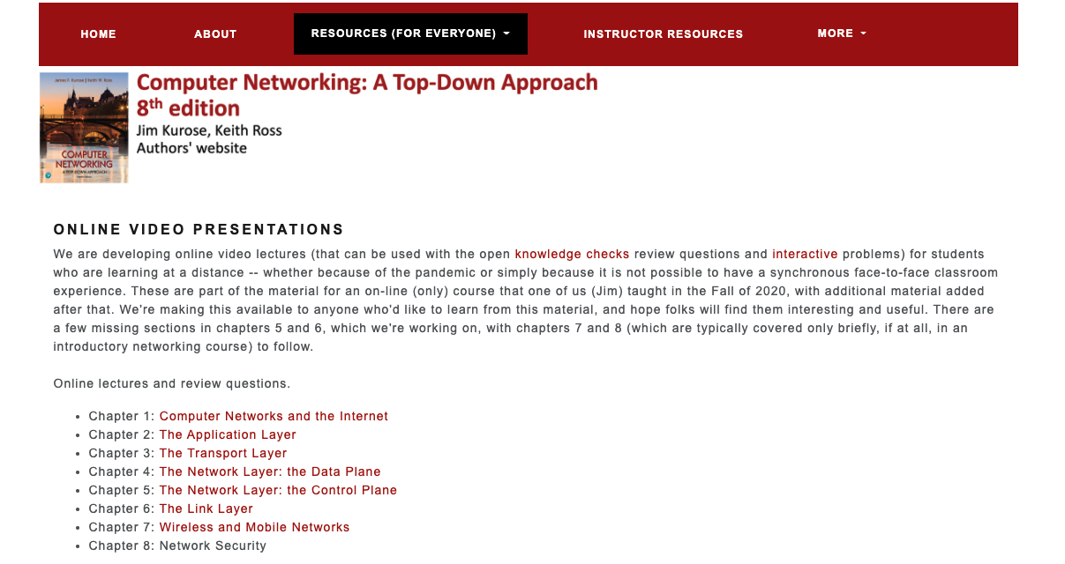
Resources
Online recording of lectures from the authors
https://gaia.cs.umass.edu/kurose_ross/lectures.php
Online lectures and review questions.
Chapter 1: Computer Networks and the Internet
Chapter 2: The Application Layer
Chapter 3: The Transport Layer
Chapter 4: The Network Layer: the Data Plane
Chapter 5: The Network Layer: the Control Plane
Chapter 6: The Link Layer
Chapter 7: Wireless and Mobile Networks
Chapter 8: Network Security

